Slide 1

Transforming risk into trust
Munich Re Group
Company Presentation
Image: Sasi Ponchaisang / EyeEm / Getty Images

Slide 2
Munich Re Group
Creating value through its diversified business model and innovative strength
Munich Re Group is one of the
world’s leading risk carriers with
more than 140 years of unrivalled
risk-related expertise.
… covers the entire value chain
of reinsurance, primary insurance, insurance related services and capital market solutions.
… maintains with 42,812 employees
a global presence in 50+ countries.
… plays a key role in addressing and insuring climate risks to make the world more resilient.
… provides coverage for extraordinary risks such as rocket launches, renewable energies or cyberattacks.
… drives the digital transformation of the insurance industry in order to push forward the boundaries
of insurability.

Slide 3













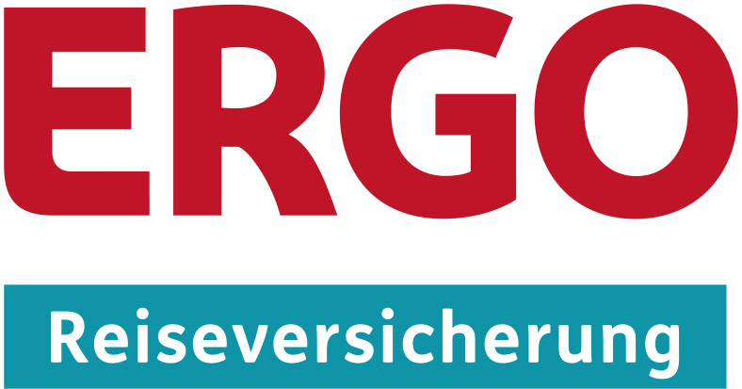

Munich Re Group
Strong business fields under one roof
Munich Re Group
exists of well-known brands standing for extraordinary expertise in reinsurance,
primary insurance and asset management.
Group
Reinsurance
Primary
insurance
Asset
Management

Slide 4
Munich Re Group
Convincing through strong financials and stable partnership
Munich Re Group commands
the trust of financial markets,
as evidenced by its excellent
financial ratings.
… offers financial stability and reliability, even in the event of exceptionally high losses like the 2017 Atlantic hurricanes or
the 2019 Pacific typhoons.
A+ (A.M. Best)
AA (Fitch)
… is one of the world’s most sought-after risk partner for business, institutions and private individuals because of its close proximity to clients’ needs and reliable partnership.
Aa3 (Moody’s)
AA- (Standard & Poor’s)

Slide 5
Munich Re Group
Powerful financials inspire trust of customers and investors
Key Figures based on annual report 2023
IFRS consolidated result
Insurance revenue from
insurance contracts issued
€4,597m
€57.9bn
Reinsurance consolidated result
Dividend proposal per share
by the Board of Management
€3,876m
€15
ERGO consolidated result
Solvency II ratio
€721m
267%

Slide 6
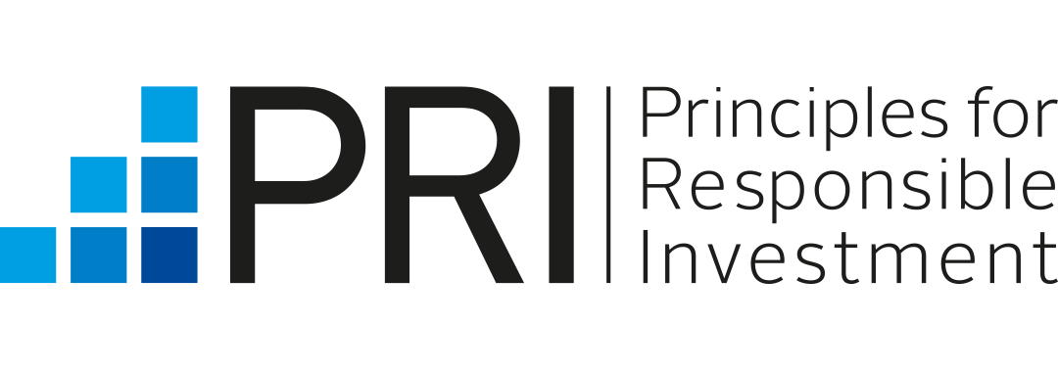




Munich Re Group
A strong commitment towards sustainability – International co-operations
UNEP FI
(since 1999)
Munich Re has signed the UNEP FI’s climate declaration and was a founding member of the PRI and PSI.
Principles for Responsible Investment (PRI)
(since 2006)
Munich Re actively developed the
UN Principles for Responsible Investment
(PRI) and has since also joined the
Net-Zero Asset Owner Alliance at the beginning of 2020.
UN Global Compact
(since 2007)
Munich Re has been a member of the
UN Global Compact since August 2007.
The ten principles of the UN Global Compact provide guidance for action in
our business and set the basis for our sustainability activities.
Principles for Sustainable Insurance (PSI)
(since 2012)
Munich Re played an active part in developing the Principles for Sustainable Insurance (PSI) and was a founding signatory in June 2012.

Slide 7
Munich Re Group
Holistically integrating ESG across the organisation
Ambitious decarbonisation targets
Climate targets for our (re)insurance business
Decarbonisation of our investments
Reduction of our own emissions
Climate-related disclosure
Aligned with the Task Force on Climate-
Related Financial Disclosures (TCFD)
Analysing the consequences of climate
change for more than 40 years
Environmental
Diverse workforce
40% managers to be female by 2025
25% women in BoM by 2025
60+ nationalities
80+ professions
Employer of choice
Comprehensive training and
development programmes
Measuring employee satisfaction
Promoting digital culture and shaping
new ways of working
Social
ESG criteria in
BoM remuneration
ESG criteria relevant for
variable remuneration and
multi-year bonus.
Sound ESG
governance ​
Board-Level “ESG Committee” and high- level “ESG Management Team” with top managers from different business fields.
Winner in
Governance Ranking
“Excellent“ rating in the
2021 DVFA Scorecard for
Corporate Governance,
1st rank of DAX 40 companies.
Governance

Slide 8
Munich Re Group
Spotlight on Climate – Munich Re’s role as investor, underwriter and public voice
Assets
Liabilities
Own operations
Comprehensive
climate risk
management
Climate risk management on both, assets and liabilities
  Physical risks
  Transition risks
  Reputational and ESG risks
  Litigation risks
Improving operational emissions
and efficiency.
Ambitious
decarbonisation
targets
Carbon-neutral since 2015
Net-zero emissions by 2030
Total: net-zero (2050)
Thermal coal: full exit (2040)
Oil and gas: net-zero (2050)
Thermal coal: full exit (2040)
Decarbonisation strategy for
treaty business
Innovative
climate solutions
Investing in low-carbon technologies
and green innovations
Green bond issuance
Climate risk analysis services
Risk transfer solutions for climate mitigation and adaptation
Social engagement projects
focusing on climate change.
Initiatives and partnerships
Global partnerships for collaborations and innovation towards climate-friendly solutions
Providing expertise as a public voice to advocate for climate action and resilience
Global partnerships for collaborations and innovation towards climate-friendly solutions
Providing our expertise as a public voice to advocate for climate action and resilience

Slide 9

Munich Re Group Ambition 2025
Scale. Shape. Succeed.
Expansion of core
Preference for organic growth
Leverage superior underwriting
Uplift asset performance
Scale
Succeed
Shareholders
Growing earnings and RoE.
Clients
Long-term partner – superior
products, experience and capacity.
Employees
Employer of choice: skill-driven,
fostering digital culture, risk entrepreneurs.
Communities
Comprehensive climate
strategy matching
Paris Agreement.
Create additional business
Monetize digital business investments
Create new strategic options
Shape

Slide 10

Munich Re Reinsurance Group
Pioneering concepts that make tomorrow’s world insurable
One of the world’s
leading reinsurers.
4000+ corporate clients
in 160+ countries.
Life, health and property-
casualty business.
Extensive underwriting experience, global and local market insight and
cross-segment expertise.
Specialized products, customized insurance solutions & services to fully serve the needs of clients handling industrial or major project business.
Business with primary insurers directly, via brokers and within the framework of strategic partnerships.

Slide 11
Munich Re Group Ambition 2025 – Reinsurance
Leading the evolution of the reinsurance industry as a strong multifaceted player
Core P-C RI
Leading global reinsurer
in Property-casualty.
Risk Solutions
Leading specialty insurer in selective businesses based on UW expertise.
L&H Reinsurance
Leading global reinsurer
in Life and Health.
Grow in hardening markets and
strengthen footprint.
Increase share of Risk Solutions by leveraging
on strong core.
Build on growth from underlying markets
and strong foundation.
Succeed
Scale
Shareholders
Industry leading RoE.
Clients
Long-term partner – superior
products, experience and capacity.
Employees
Attractive employer – skill driven,
digital culture, risk entrepreneurial.
Communities
Comprehensive climate
strategy matching
Paris Agreement.
Expand in new
business opportunities.
Develop new products
and improve operations.
Drive new business opportunities.
Shape
Innovation
Start
monetizing
Develop strategic options based on our expertise in global risk-transfer and beyond
Start monetizing on mature investments
Continuously explore playing fields for further strategic options

Slide 12
ERGO Group AG
One of the leading insurance providers in Germany on course for growth
ERGO Group AG
Headquartered in Düsseldorf, Germany; offices in 30 countries around the world.
38,000 employees
and sales agents.
Focusing on the
core market Europe with growth in Eastern and Southern Europe and the growth market Asia, primarily India
and China.
ERGO
Deutschland AG
German Business.
ERGO
International AG
International Business.
Comprehensive range of insurance, investments and services.
Extensive expertise, diversified sales channels, experience
in local partnerships
and specific demands
of individual markets.
ERGO Digital
Ventures AG
Digital and direct activities.
ERGO Technology &
Services Management AG
Global technology and service provider for the
entire Group.

Slide 13

Munich Re Group Ambition 2025 - ERGO
The new strategic phase applies to all parts of ERGO Group
Germany
Top player position
with market
leading profitability.
International
Top peer profitability
in European markets.
Digital projects and technology
Technology enabled value chain
and transfer of digital assets.
Secure profitability
and market position
through first-rate
customer experience.
Increase net profit contribution of the international portfolio.
Build up strong growth
in B2B2C and pure direct player.
Continue modernization of legacy IT-infrastructures.
Succeed
Shareholders
Top peer group RoE.
Customers
Customer-centric processes, products and services.
Employees
Attractive work environment through
new ways of working and technology.
Strengthen digital employer branding.
Leverage the strengths, innovative spirit
and diversity of our workforce.
Communities
Partner of local communities.
Clearly set goals according
to the Paris Agreement.
Scale
Strengthen Hybrid
Customer-centric
business model.
Expand cross-border synergies and utilization
of technological solutions.
Explore emerging
ecosystems in Mobility
and Travel; enhanced digital footprint in all segments.
“Digital first” in all customer- facing applications.
Shape

Slide 14
MEAG Munich ERGO Asset Management GmbH
One of the most important players in the international asset management
Primary asset manager
for Munich Re Group.
€340bn in assets
under management.
Highly experienced investment managers pursuing a rigorous risk-controlled investment approach.
as of 31 December 2023
Offices in Europe, Asia
and North America.
Investment in all main asset classes, including interest-bearing securities, equities, real estate, renewable energies and infrastructure.
Award winning expertise
and quality.

Slide 15
Outlook
Key investment challenges
Integrating ESG
Net-zero greenhouse gas emissions by 2050
Low interest rates
Mitigating yield attrition without increasing risk
Capital market volatility
Portfolio resilience and market opportunities

Slide 16
Thank you for your interest!
Image: Sasi Ponchaisang / EyeEm / Getty Images

